Slide 1



Academic Session 2020-21 (Even Semester)
Department of Computer Engineering

Slide 2

Self-Introduction
Name: Deepak Moud
Qualification: BE, MTECH, PhD(Persuing)
Designation: Head of Department
Research Area: Image Processing, Machine Learning, Deep learning, data Mining
E-mail Id: deepakmoud@poornima.org
Phone Number: 07568748510

Slide 3
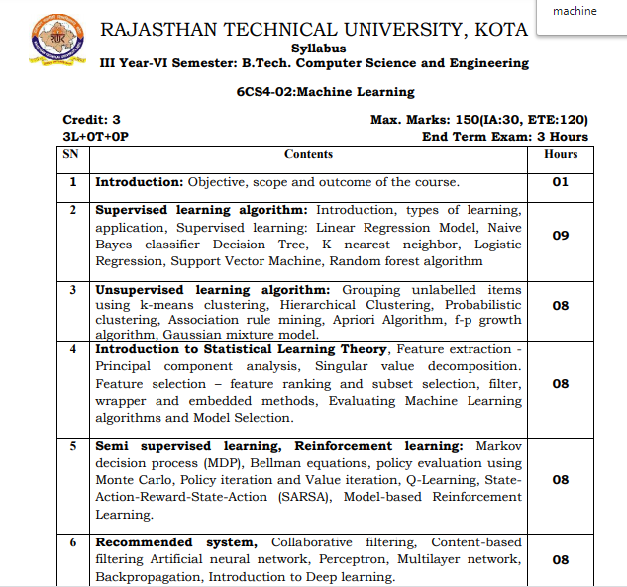
Syllabus

Slide 4
Books
Sr. No. | Title of the book | Author
1 | Machine Learning | Anuradha Srinivasaraghavan, Vincy Joseph
2 | Data Mining Concepts and Techniques | Jiawei Han University of Illinois at Urbana–Champaign Micheline Kamber Jian Pei Simon Fraser University

Slide 5
This document contains images obtained by routine Google Images searches. Some of these images may perhaps be under copyright. They are included here for educational and noncommercial purposes and are considered to be covered by the doctrine of Fair Use. In any event they are easily available from Google Images.
Public Notice regarding Use of Images
It's not feasible to give full scholarly credit to the creators of these images. We hope they can be satisfied with the positive role they are playing in the educational process.
2

Slide 6
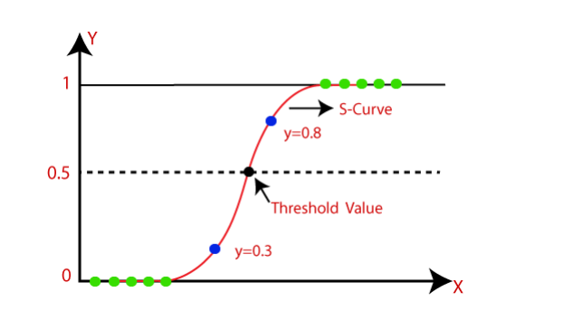
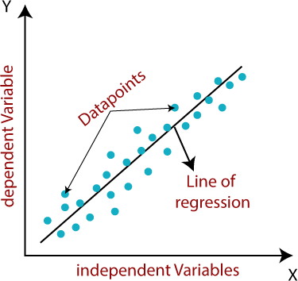
Logistic Regression in Machine Learning
6

Slide 7
Logistic Regression in Machine Learning
Logistic regression is one of the most popular Machine Learning algorithms, which comes under the Supervised Learning technique. It is used for predicting the categorical dependent variable using a given set of independent variables.
Logistic regression predicts the output of a categorical dependent variable. Therefore the outcome must be a categorical or discrete value. It can be either Yes or No, 0 or 1, true or False, etc. but instead of giving the exact value as 0 and 1, it gives the probabilistic values which lie between 0 and 1.
Logistic Regression is much similar to the Linear Regression except that how they are used. Linear Regression is used for solving Regression problems, whereas Logistic regression is used for solving the classification problems.
In Logistic regression, instead of fitting a regression line, we fit an "S" shaped logistic function, which predicts two maximum values (0 or 1).
7

Slide 8
Logistic Regression in Machine Learning
The curve from the logistic function indicates the likelihood of something such as whether the cells are cancerous or not
Logistic Regression is a significant machine learning algorithm because it has the ability to provide probabilities and classify new data using continuous and discrete datasets.
Logistic Regression can be used to classify the observations using different types of data and can easily determine the most effective variables used for the classification. The below image is showing the logistic function:
8

Slide 9
Logistic Function (Sigmoid Function):
The sigmoid function is a mathematical function used to map the predicted values to probabilities.
It maps any real value into another value within a range of 0 and 1.
The value of the logistic regression must be between 0 and 1, which cannot go beyond this limit, so it forms a curve like the "S" form. The S-form curve is called the Sigmoid function or the logistic function.
In logistic regression, we use the concept of the threshold value, which defines the probability of either 0 or 1. Such as values above the threshold value tends to 1, and a value below the threshold values tends to 0.
9

Slide 10

Logistic Function (Sigmoid Function):
The Logistic regression equation can be obtained from the Linear Regression equation.
The mathematical steps to get Logistic Regression equations are given below:
We know the equation of the straight line can be written as:
In Logistic Regression y can be between 0 and 1 only, so for this let's divide the above equation by (1-y):
But we need range between -[infinity] to +[infinity], then take logarithm of the equation it will become: The above equation is the final equation for Logistic Regression.
10

Slide 11
Type of Logistic Regression
On the basis of the categories, Logistic Regression can be classified into three types:
Binomial: In binomial Logistic regression, there can be only two possible types of the dependent variables, such as 0 or 1, Pass or Fail, etc.
Multinomial: In multinomial Logistic regression, there can be 3 or more possible unordered types of the dependent variable, such as "cat", "dogs", or "sheep"
Ordinal: In ordinal Logistic regression, there can be 3 or more possible ordered types of dependent variables, such as "low", "Medium", or "High"
11

Slide 12
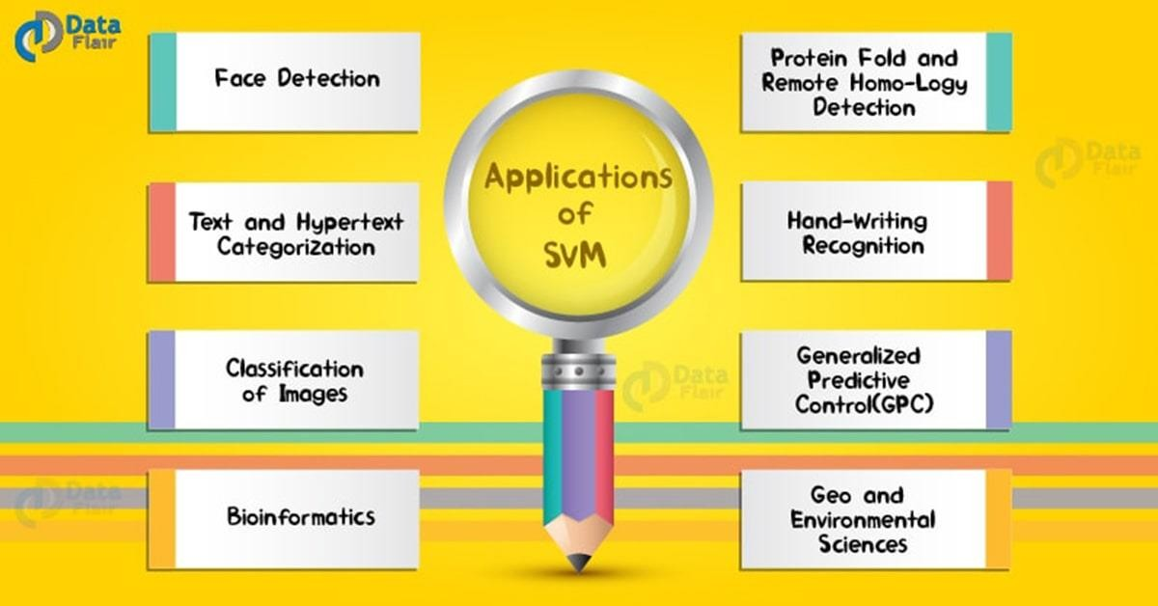
May 22, 2020
30

Slide 13
Example of Logistic Regression
User ID | Gender | Age | EstimatedSalary | Purchased
15624510 | Male | 19 | 19000 | 0
15810944 | Male | 35 | 20000 | 0
15668575 | Female | 26 | 43000 | 0
15603246 | Female | 27 | 57000 | 0
15804002 | Male | 19 | 76000 | 0
15728773 | Male | 27 | 58000 | 0
15598044 | Female | 27 | 84000 | 0
15694829 | Female | 32 | 150000 | 1
15600575 | Male | 25 | 33000 | 0
15727311 | Female | 35 | 65000 | 0
15570769 | Female | 26 | 80000 | 0
15606274 | Female | 26 | 52000 | 0
15746139 | Male | 20 | 86000 | 0
15704987 | Male | 32 | 18000 | 0
15628972 | Male | 18 | 82000 | 0

